Slide 1
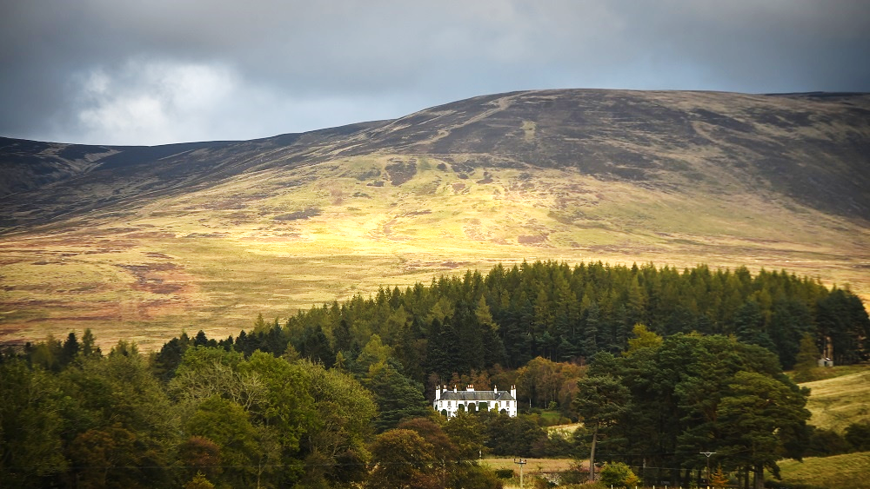
Notes:
ROTTAL ESTATE

Slide 2

LANDSCAPE LEADERSHIP
DAVID MICHIE
DEPUTY DIRECTOR
SOIL ASSOCIATION SCOTLAND
Notes:
HELLO, DIVERSITY, MIX, COMMON CONCERN FOR ENVIRONMENT AND OPPORTUNITIES FOR RENEWAL OF THE RURAL SECTOR

Slide 3
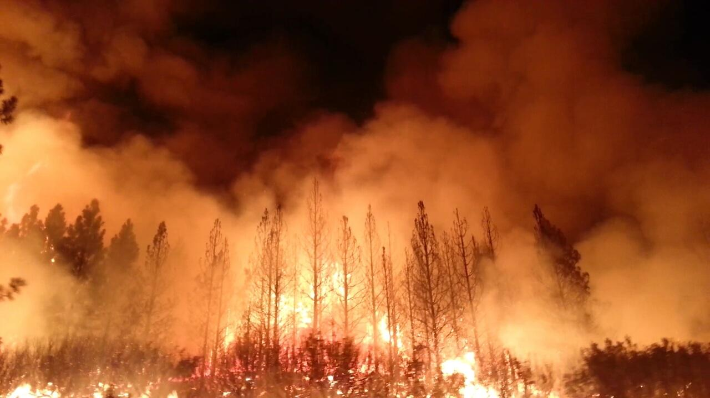
Notes:
Why are we here? We know that climate is impacting us right now. Local solutions to global problems. Change at scale. Stewardship – opportunity to be part of the solution and to make impactful change for future generations. A big change is needed now.

Slide 4
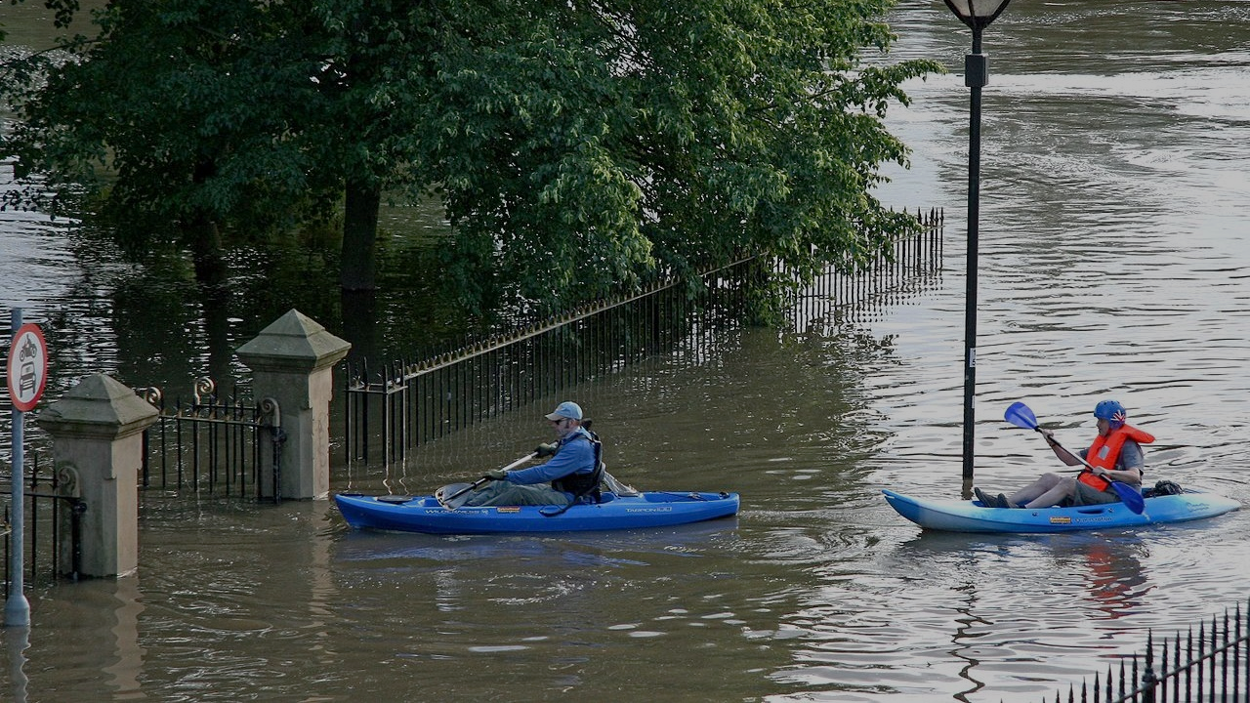
Notes:
And we are also feeling the consequences in Britain as well – with the recent flooding famously in Fishlake. There was an announcement to spend millions on concrete – but no word about what they would do upstream – investments in land nature and climate friendly land management that has economic, employment, and wider environmental benefits.

Slide 5
“As First Minister of Scotland I am declaring that there is a climate emergency; and Scotland will live up to our responsibility to tackle it…
Later this week, the Committee on Climate Change will publish new scientific advice on Scotland’s targets. I am making this public promise to the young people I met, and to their entire generation. If that advice says that we can go further or faster, we will do so. We will lead by example.”
Nicola Sturgeon, April 2019
Notes:
There is the political will to make a change, and we know that things are changing. In 2019 the context shifted significantly. We have a sense of direction from the First Minister – but the policy deliverability of this is unclear. We need land managers to lead our policymakers.

Slide 6
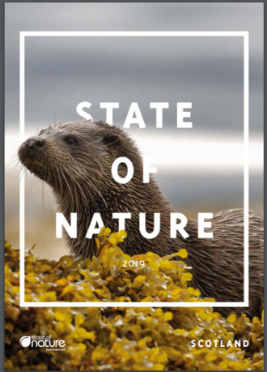
48% of species in Scotland have seen their populations decline in the last 10 years
33% of our wildlife is found in fewer places than in 1970
Notes:
This report was written by the National Biodiversity Network. We have a climate emergency, but there is also a wildlife crisis. We also owe this to future generations, we have a moral responsibility to all do our bit for wildlife.
But this programme is not about telling you that the world is in a terrible state. It is about capacity building to make change.

Slide 7
“It is not nature versus the economy; it is investing in nature to increase prosperity.”
Green and Prosperous Land, Dieter Helm, 2019
Notes:
With this context, a lot of thinking is being done on how to shift the way we do things. And this course is about getting you on the front foot to take the new opportunities that this presents. Land is a vital asset that you are all involved in. It can be used to address these climate and nature challenges. Tomorrow you will learn more about natural capital and the opportunities this concept provides.

Slide 8
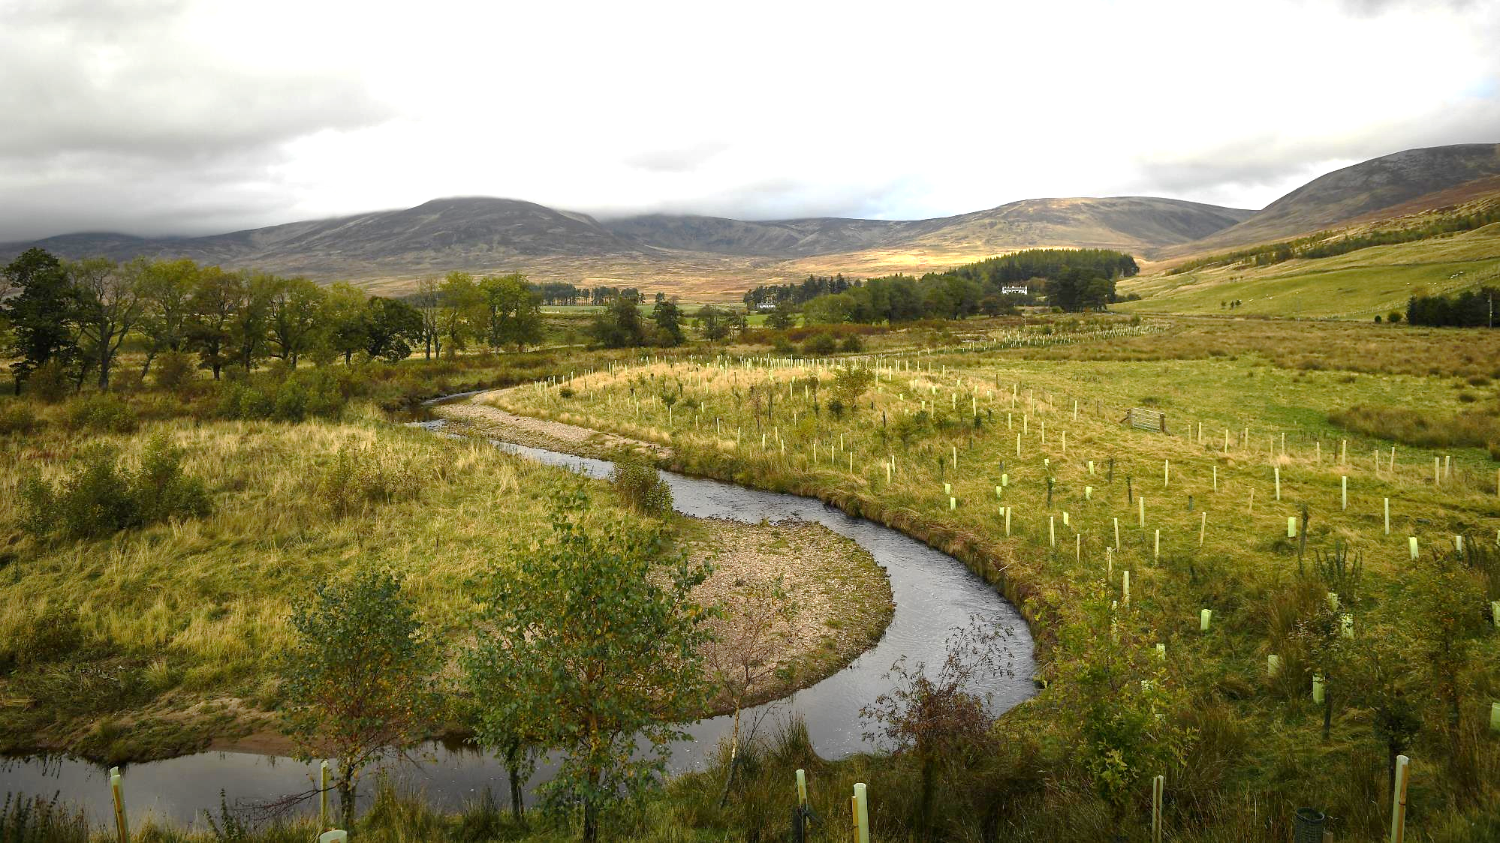
Notes:
Remeandering – more salmon and pearl mussels – doubled populations – more fish (food, an ecosystem service) to catch – more attractive to anglers – economic benefits to the estate as well as reducing diffuse pollution and sequestering carbon and reducing flood risk from riparian planting. Done in partnership with other estates on the catchment, Angus Council, and the Fisheries Trust, RSPB and others in the River South Esk partnership.

Slide 9
The group will provide leadership on the biggest challenges facing the natural environment in Scotland and the world: wildlife and climate change. There has been a lack of political leadership in rural Scotland on these vitally important issues and the aim of the programme is to enable, empower, and connect influential leaders with the capacity to make change.
Notes:
I’m going to end with the pitch, invite you to read it, and ask any questions.

