Slide 1

Leadership Models
Emma Cooper
Facilitator & Coach
SOIL ASSOCIATION SCOTLAND
Notes:
What is leadership – more importantly, what is good leadership?

Slide 2
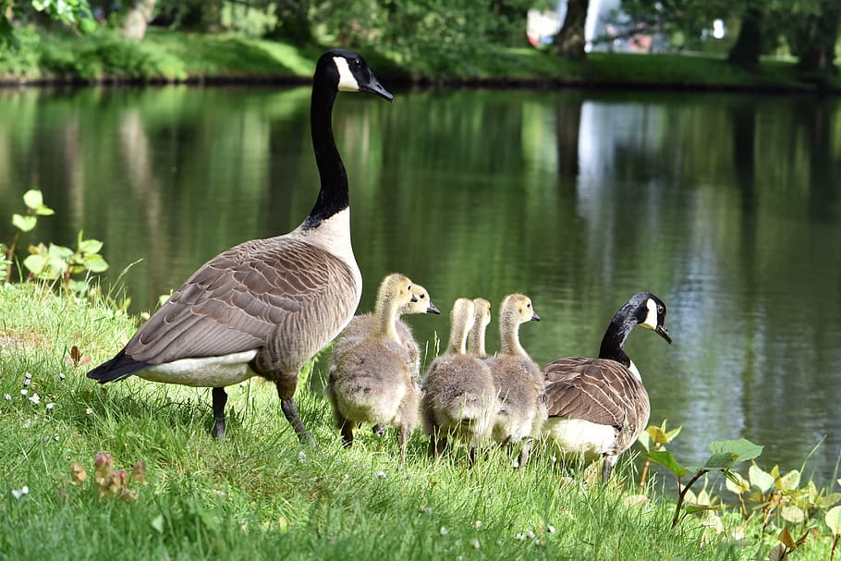
Leader, manager or follower?
Notes:
We have to, and do, take these different roles at different times, and often we lead when we are not allocated that role – people lead at all different levels of an organisation. This course focuses on leadership, but being a good manager and a good follower are elements of good leadership.

Slide 3
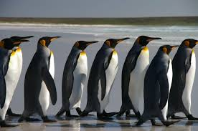
Followership
Definition: The willingness to cooperate in working towards the accomplishment of the group mission
Notes:
Followership is just as important as leadership, if not more so. It does not mean blindly following a leader – it means active participation in meeting an organisations objectives, getting stuck in and delivering. It means offering support to others when they are in a leadership role, and fostering the leadership skills of others. A good follower works independently, is accountable for their actions and takes the necessary ownership of tasks; they do not abdicate responsibility, deliver the minimum required or stop thinking for themselves. Good followers support leaders, but also provide a check on leaders. Leaders are not infallible; good followers recognise this and can appropriately challenge when needed. You need to be a good follower, and you need to foster good followership. How? Understand and value all of the roles in your organisation. Provide opportunities for people to learn all of the different roles, consciously and reflectively. Teach accountability, critical thinking. Include it in performance evaluations. Create structures that allow for people to try all these roles – rotating leadership for example in small teams. When have you been a good follower – what skills, knowledge, traits were in play?

Slide 4
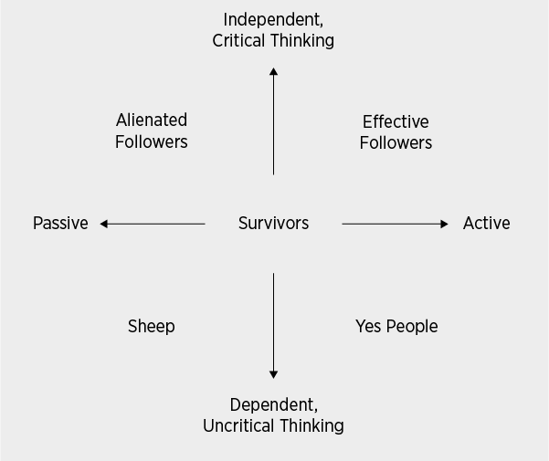
Notes:
Followership is just as important as leadership, if not more so. It does not mean blindly following a leader – it means active participation in meeting an organisations objectives, getting stuck in and delivering. It means offering support to others when they are in a leadership role, and fostering the leadership skills of others. A good follower works independently, is accountable for their actions and takes the necessary ownership of tasks; they do not abdicate responsibility, deliver the minimum required or stop thinking for themselves. Good followers support leaders, but also provide a check on leaders. Leaders are not infallible; good followers recognise this and can appropriately challenge when needed. You need to be a good follower, and you need to foster good followership. How? Understand and value all of the roles in your organisation. Provide opportunities for people to learn all of the different roles, consciously and reflectively. Teach accountability, critical thinking. Include it in performance evaluations. Create structures that allow for people to try all these roles – rotating leadership for example in small teams. When have you been a good follower – what skills, knowledge, traits were in play?

Slide 5
Leadership
Definitions:
‘The art of getting someone to do something you want done because they want to do it’
‘A process of social influence, which maximises the efforts of others, towards the achievement of a goal’
Notes:
Notice key elements of this definition:
Leadership stems from social influence, not authority or power
Leadership requires others, and that implies they don’t need to be “direct reports”
No mention of personality traits, attributes, or even a title; there are many styles, many paths, to effective leadership
It includes a goal, not influence with no intended outcome

Slide 6
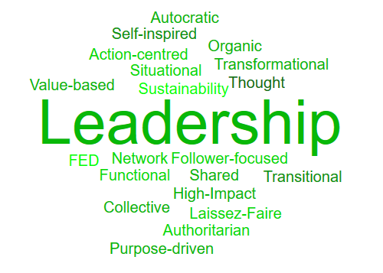
Notes:
There are endless leadership models and books – over 100,000 titles appear on Amazon – and they are constantly being updated. Some key trends have emerged however, which can help us to think about how we can be the best leader. There has been a definite shift away from seeing leaders as heroes – people who are born a certain way and us mere mortals can only follow. People no longer expect to be told what to do and to then simply do it.

Slide 7
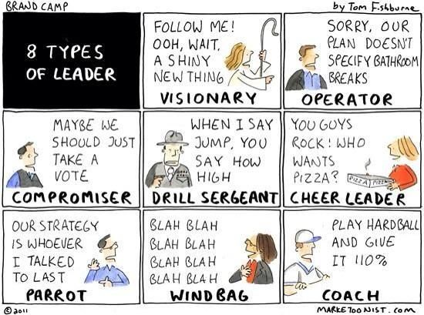
Notes:
Traditional view of leaders as heroes, they are expected to have all the answers, solve all the problems, and fix everything for everyone else. The ‘hero’ is dynamic, charismatic, and brilliant. The problem with this mind-set is that the command-and-control model often uses quick solutions that are created by a few in power and often these solutions are not well suited for the complex issues that we face today.

Slide 8
Collective leadership
Definition: A group of people working together toward a shared goal
Benefits:
Better decisions and increased effectiveness
Increased self-direction and motivation
Shared responsibility
Realising potential
Sustainability
Notes:
Collective leadership means everyone taking responsibility for the success of the organisation as a whole – not just for their own jobs or area. It is based on the recognition that without the diverse gifts, talents, perspectives, and efforts of many, sustainable change is difficult to achieve. This means that everyone has a voice and takes full responsibility for the success of the team and organisation, not just for their own jobs. It requires specific conditions for the success of the whole: trust, shared power, transparent and effective communication, accountability, and shared learning.

Slide 9
Network leadership
Definition: Collective, distributed, bottom-up, facilitative and emergent.
Benefits:
Context-aware
Empowering
Responsive and responsible
Accountability
Transparency
Notes:
Network leadership is a step further than collective leadership. It is paying real attention to the context in which you operate, and to the interaction your organisation has with others external to it. It is thinking about how can we WITH OTHERS achieve our goals. It is important because an understanding of our context, and working with others, allows us to adapt appropriately and therefore survive.

Slide 10
Sustainability leadership
CONTEXT
Internal
External
INDIVIDUAL
LEADER
Traits
Styles
Skills
Knowledge
ACTIONS
Internal
External
Notes:
Newer model – extends on collective and network. Recognises the wider impact of business or any organisation on the world, and that the impact should be positive. Accepts responsibility for our individual and collective impact on the world now and in the future, and it is taking these factors into account when making decisions. It acknowledges that in our world, poverty is increasing, climate change is happening, we have serious resource shortages which are likely to get worse, and wildlife diversity is massively reducing – and takes responsibility for doing that. Large corporations – Nestle, Unliver – at senior levels are starting to adopt this approach. They’re changing because expectations are changing.

Slide 11
Visionary | Visionary and passionate about sustainability; vision and passion must come from top management for sustainability to take hold
Systems thinker | Think “outside the box,” see the synergistic or leverage potential in relationships throughout the organization, and take a long-term view of the benefits of change
Innovator | Embrace in learning and innovating new solutions, strategies
Collaborator | Shift culture away from top-down decision-making towards increasingly collaborative, participatory culture where sustainability and other key initiatives are “everyone’s job”
Educator / advocate | Liberally share learning about sustainability with clients and competitors; do not hoard information for “competitive advantage” 4
Notes:
Defining features of Sustainability leaders -
http://www.ethicalleadership.org/uploads/2/6/2/6/26265761/sustainability_report.pdf

Slide 12
Being a better leader
Get trusted feedback
Practice your skills
Be mindful and reflective
Be honest and open
Notes:
We tend - especially when busy or stressed – to simply DO. It is essential to take time to develop your leadership skills – you can not simply expect to get better at doing something by doing it – you have to give thought to what you are doing. What worked? Why did it work? What didn’t work? How did others respond? How would someone you admire have done that differently?

Slide 13

www.soilassociation.org/landscapeleadership

