Slide 1
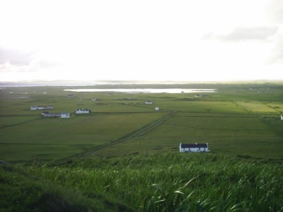
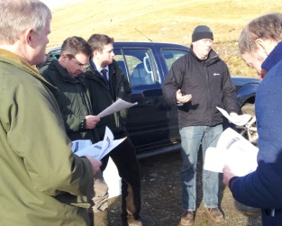
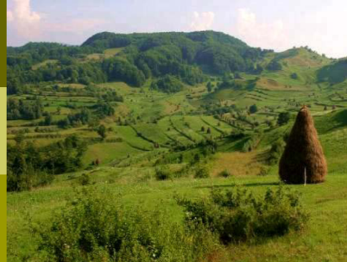
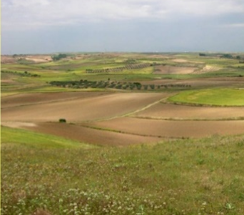
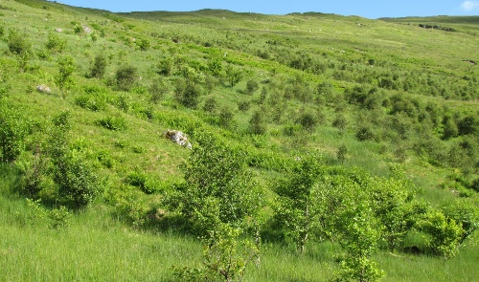
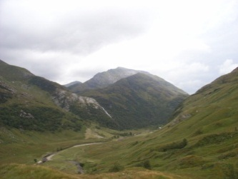
Climate change and wildlife: being part of the solution
Soil Association Scotland – Landscape Leadership Programme
What will change in Scotland in the next 10, 20, 50 years?
The Lodge, Loch Lomond, 18th February 2020
Davy McCracken
Head of Department of Integrated Land Management
Head of Hill & Mountain Research Centre
Notes:
Text is ranged left

Slide 2

Warming stripes for Scotland: 1884-2018
Average annual temperatures: https://showyourstripes.info/
Not at all
Yes – ish?
Yes
1884
1900
1920
1940
1960
1980
2000
2018

Slide 3
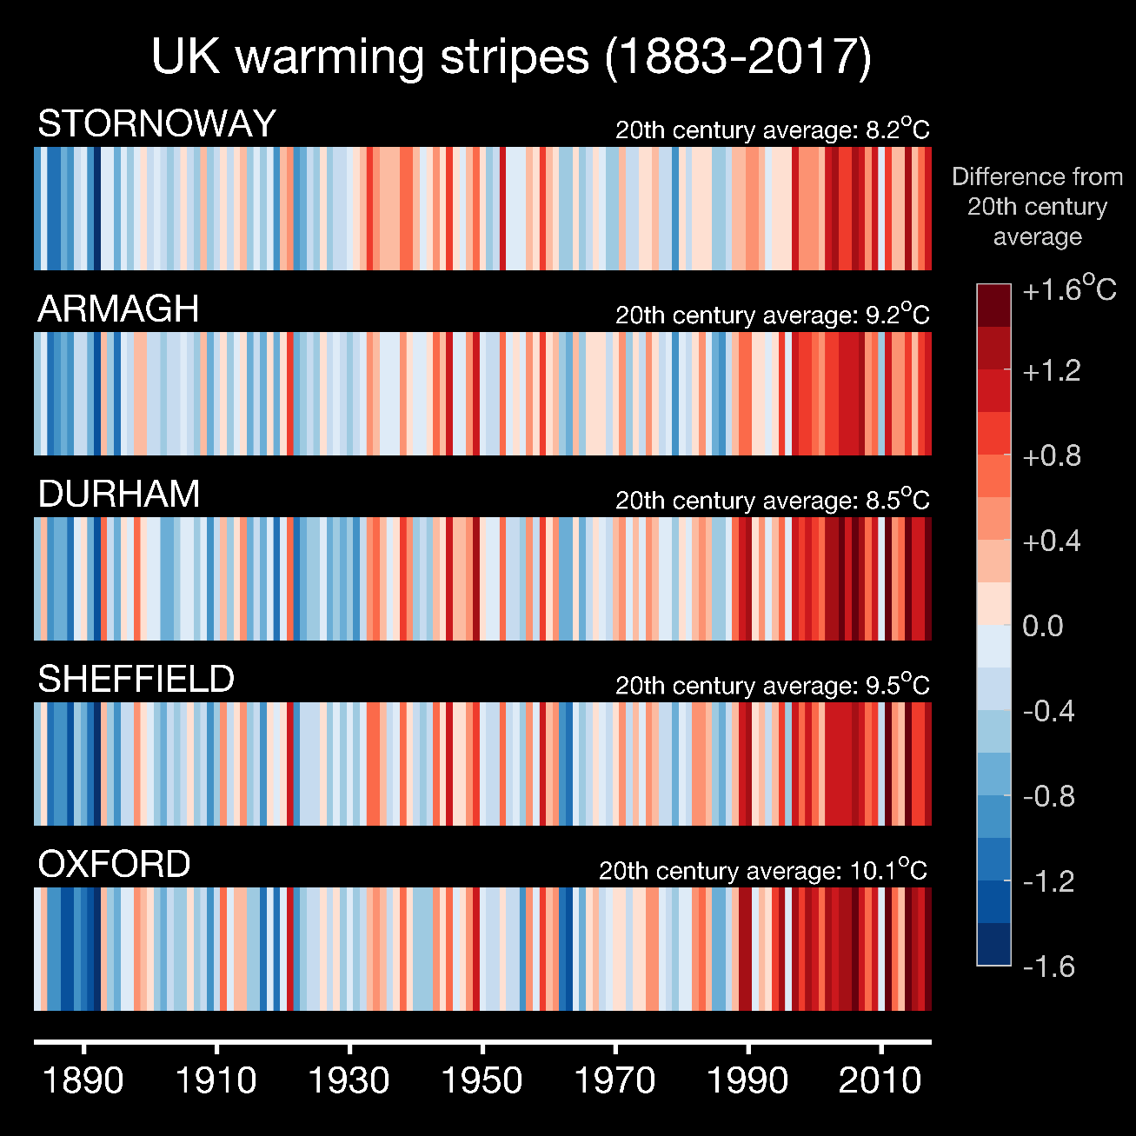
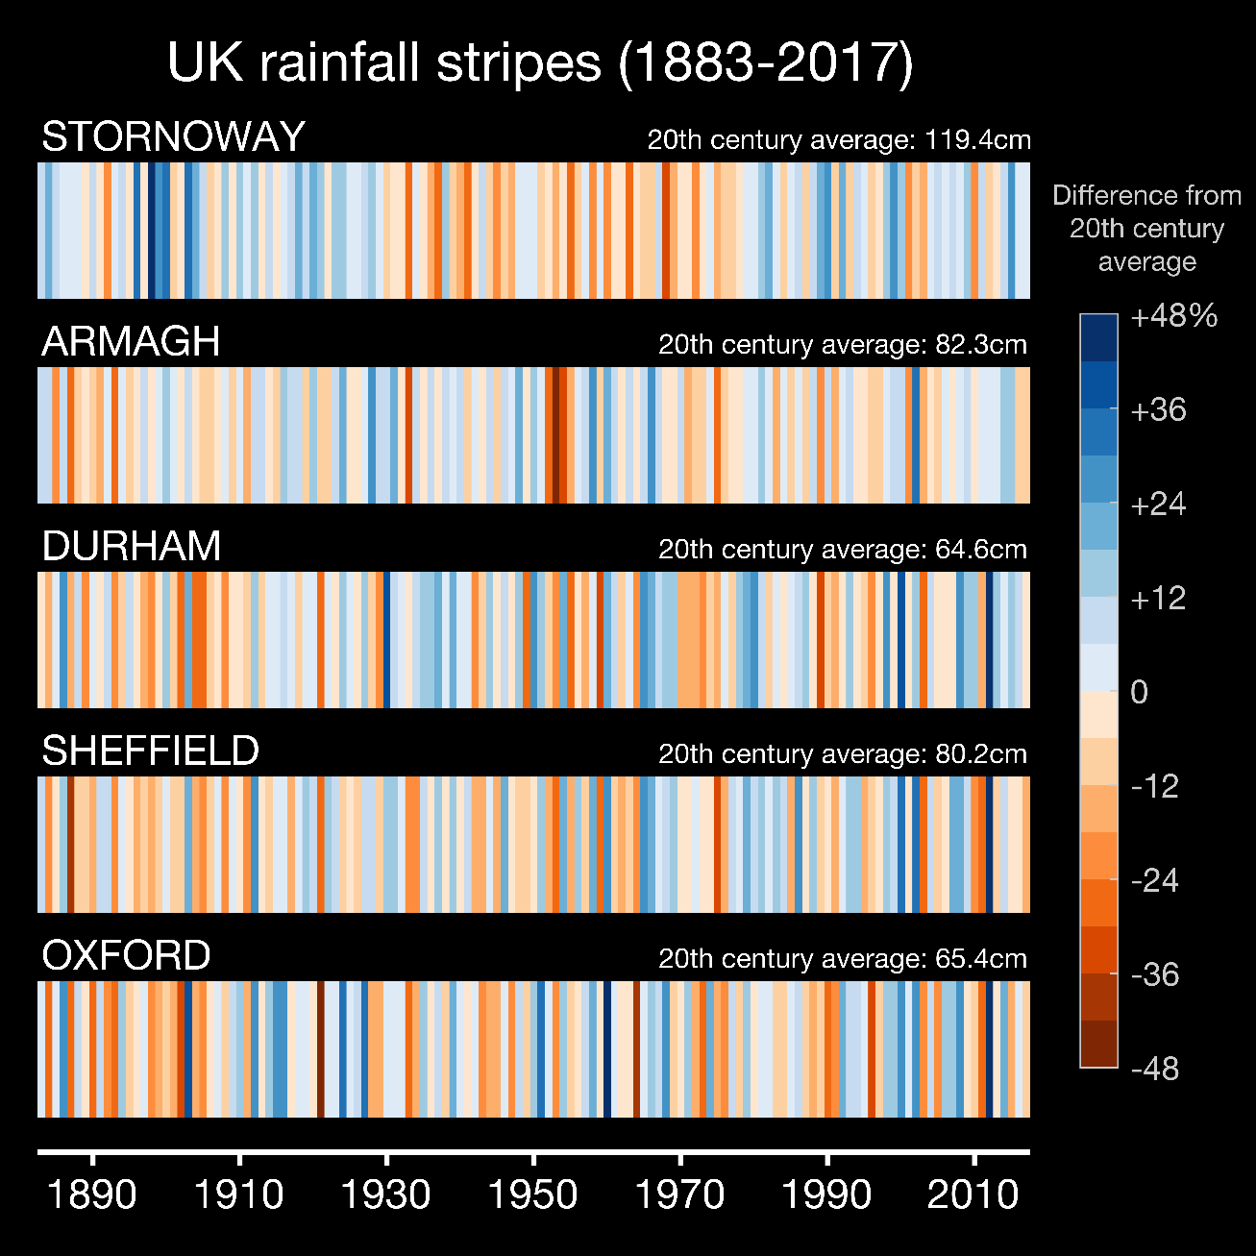
Warming stripes for UK: 1883-2017 http://www.climate-lab-book.ac.uk/files/2018/09/uk-stripes-1.png
Not very indicative of Scotland!

Slide 4
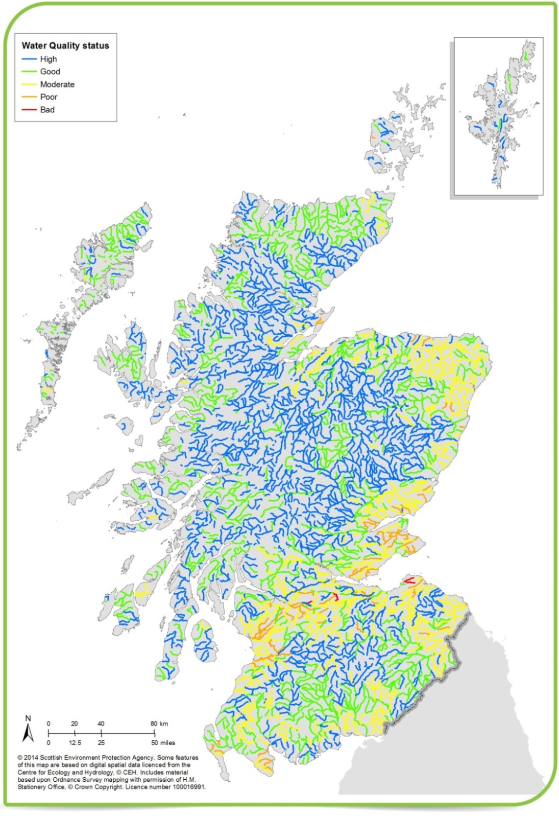
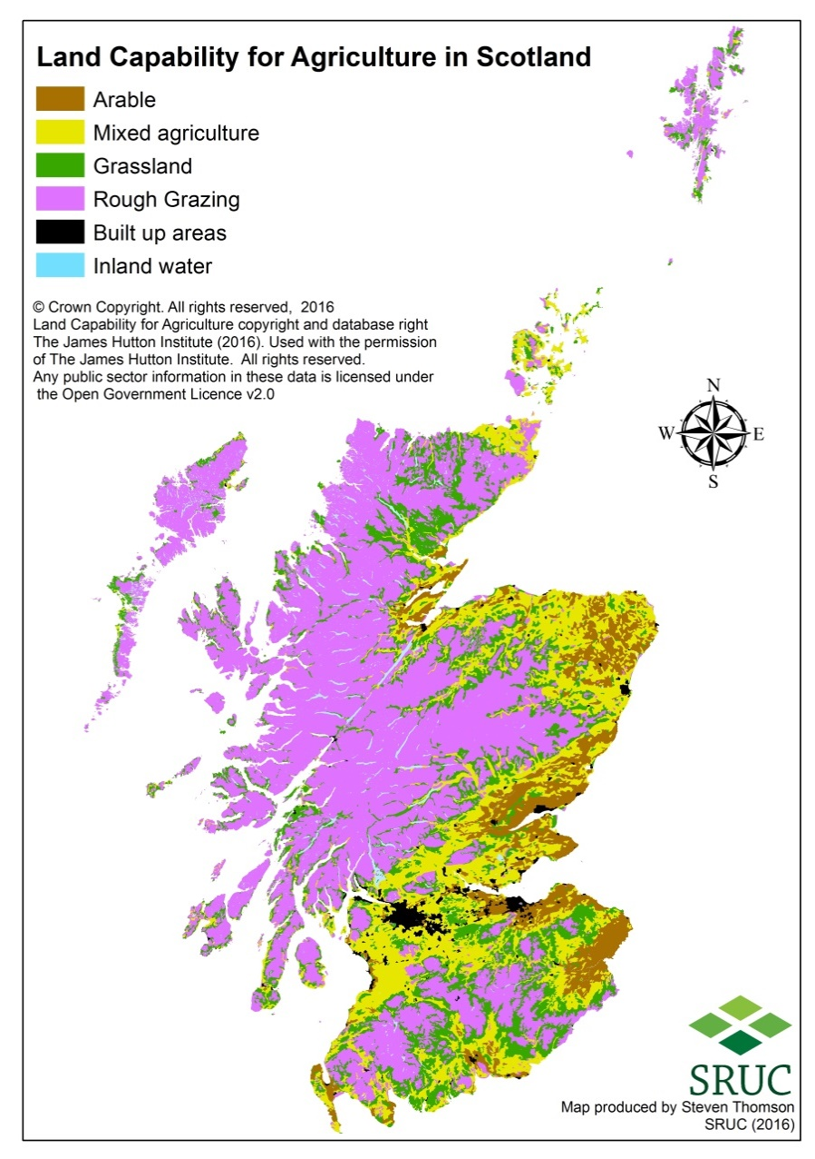
Water Quality
Detailed up-to-date data on individual rivers can be obtained at: https://www.environment.gov.scot/our-environment/state-of-the-environment/ecosystem-health-indicators/condition-indicators/indicator-6-freshwater/

Slide 5
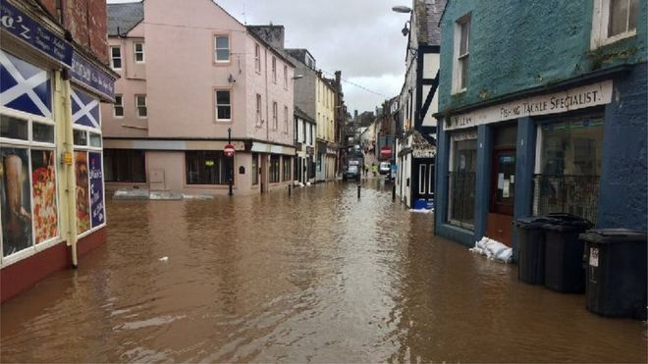

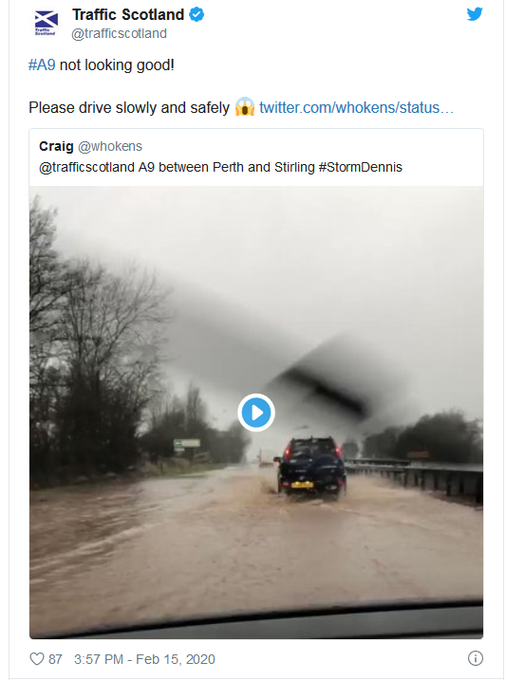
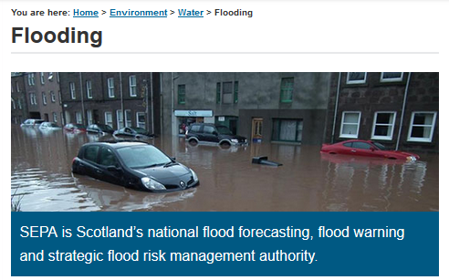
Water Quantity

Slide 6
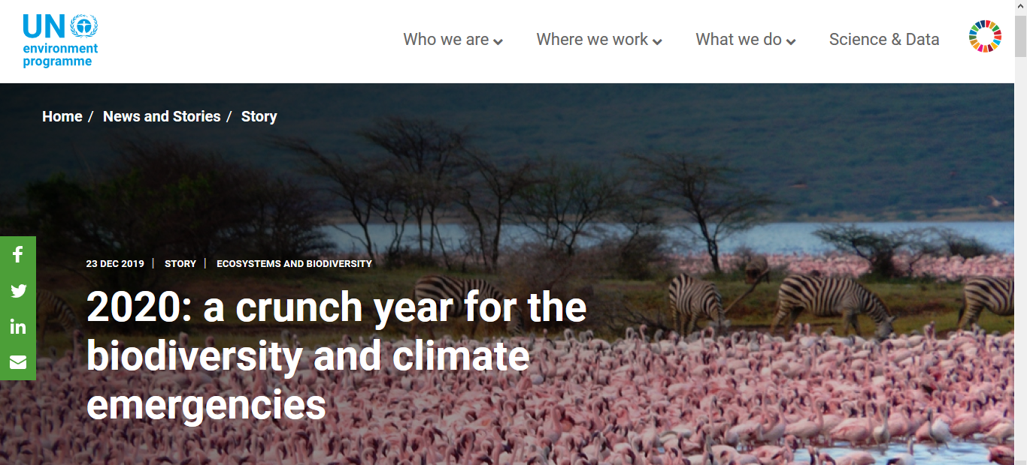
Climate Emergency AND Biodiversity Crisis

Slide 7
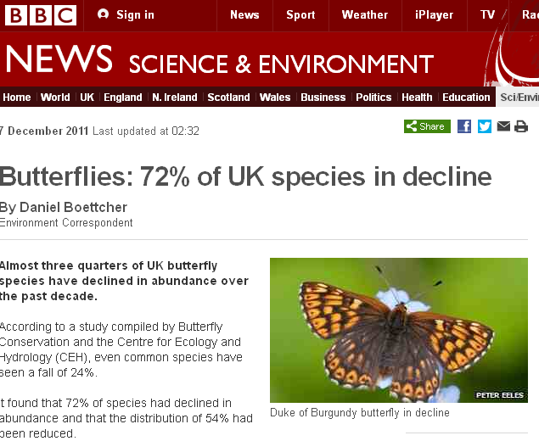
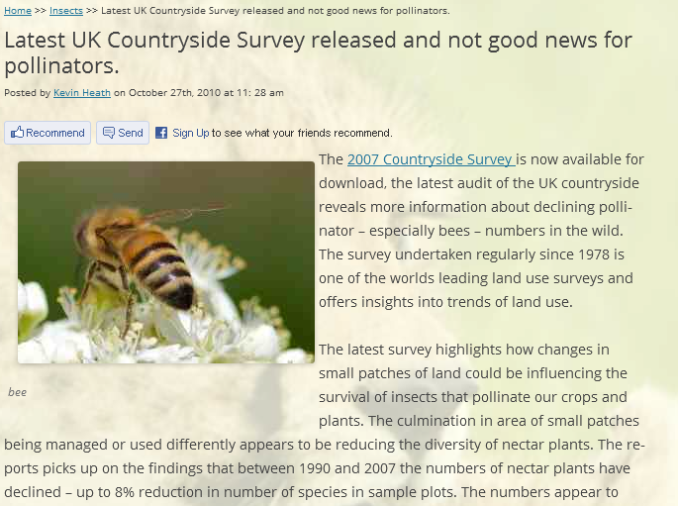
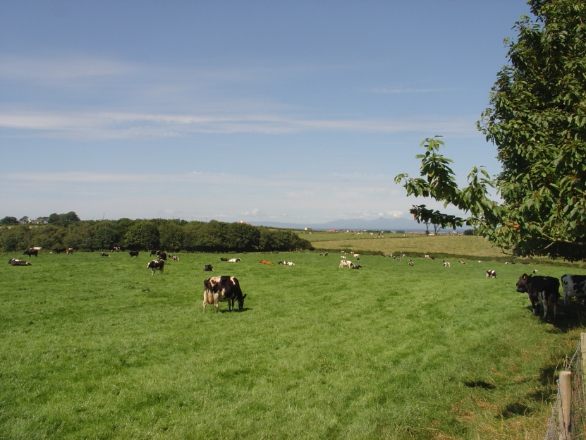
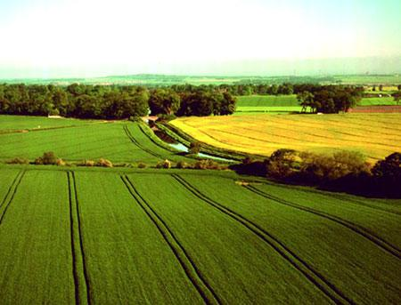

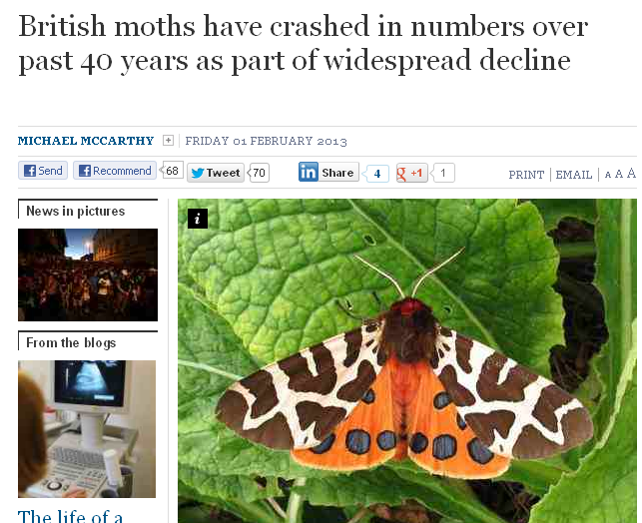

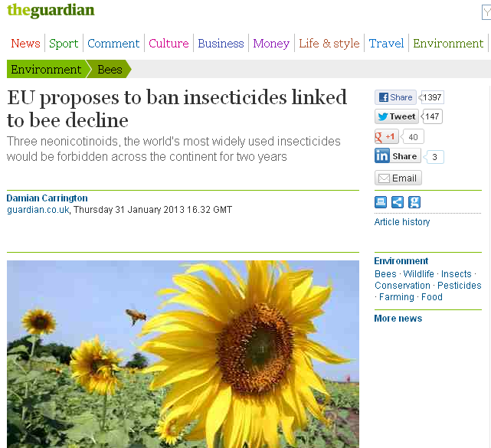
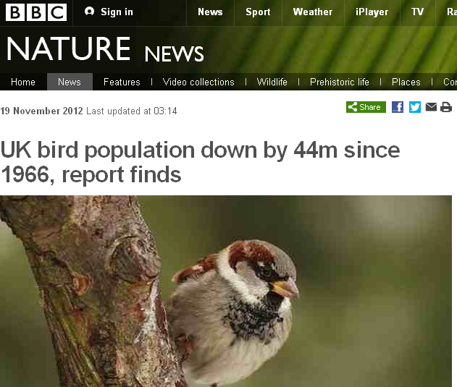


Pressures on farmland biodiversity

Slide 8
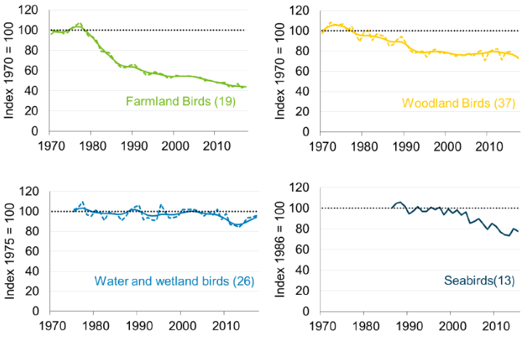
Pressures on farmland biodiversity
Scotland: 1994-2017 (BTO)
Increasing:
House Sparrow (+49%)
Yellowhammer (+32%)
Declining
Kestrel (-68%)
Curlew (-60%)
Lapwing (-57%)
Rook (-35%)
Starling (-11%)
Meadow Pipit (-10%)
Populations of UK wild birds by habitat: 1970-2017
Source: Defra, BTO, RSPB
https://www.gov.uk/government/statistics/wild-bird-populations-in-the-uk
https://www.nature.scot/sites/default/files/2018-11/Official%20Statistics%20-%20Terrestrial%20Breeding%20Birds%202018.pdf

Slide 9
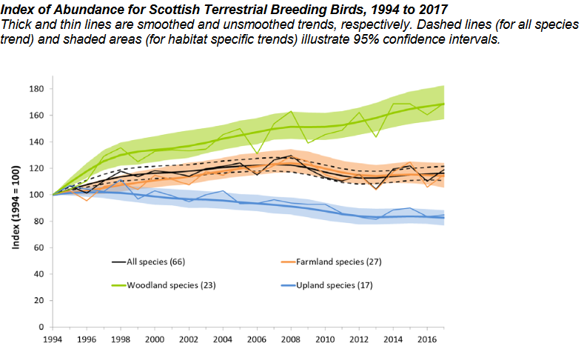
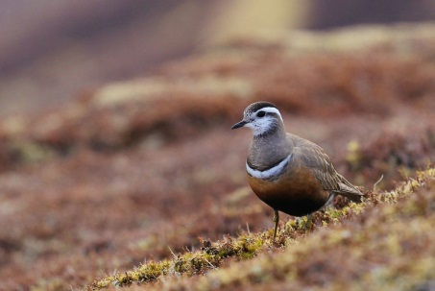
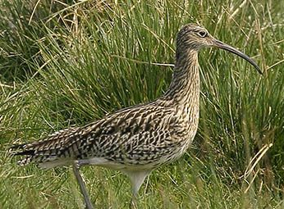
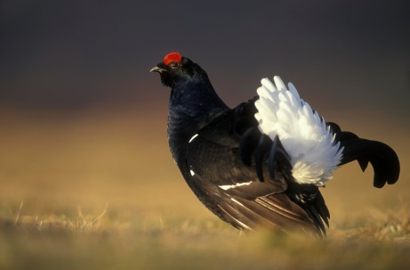
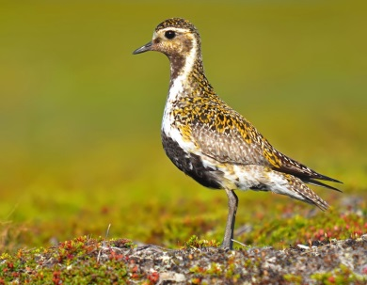
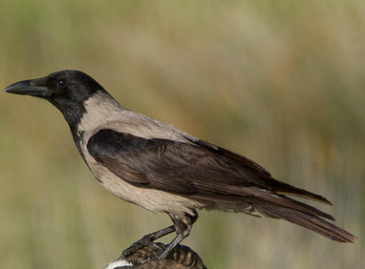
Pressures on biodiversity - uplands
1994-2017
Increasing:
Raven (+59%)
Cuckoo (+58%)
Snipe (+39%)
Declining
Dotterel (-62%)
Curlew (-60%)
Black Grouse (-55%)
Hooded Crow (-47%)
Golden Plover (-14%)
https://www.nature.scot/sites/default/files/2018-11/Official%20Statistics%20-%20Terrestrial%20Breeding%20Birds%202018.pdf

Slide 10
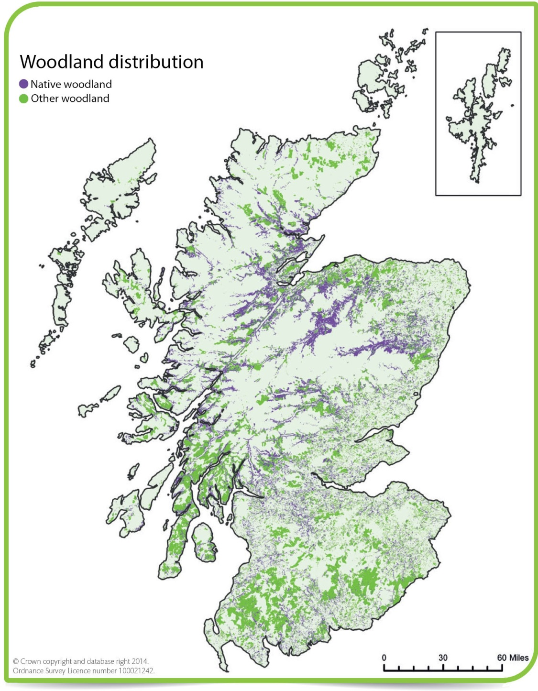
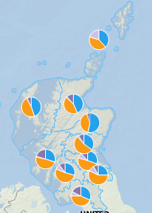
Woodland distribution and native condition (NWS 2014)
Further details can be obtained at: https://www.environment.gov.scot/our-environment/state-of-the-environment/ecosystem-health-indicators/condition-indicators/indicator-3-forests/

Slide 11
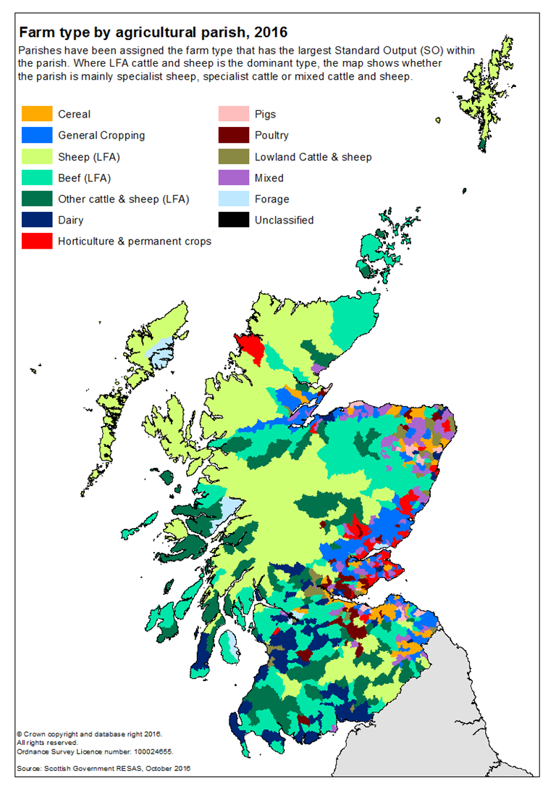
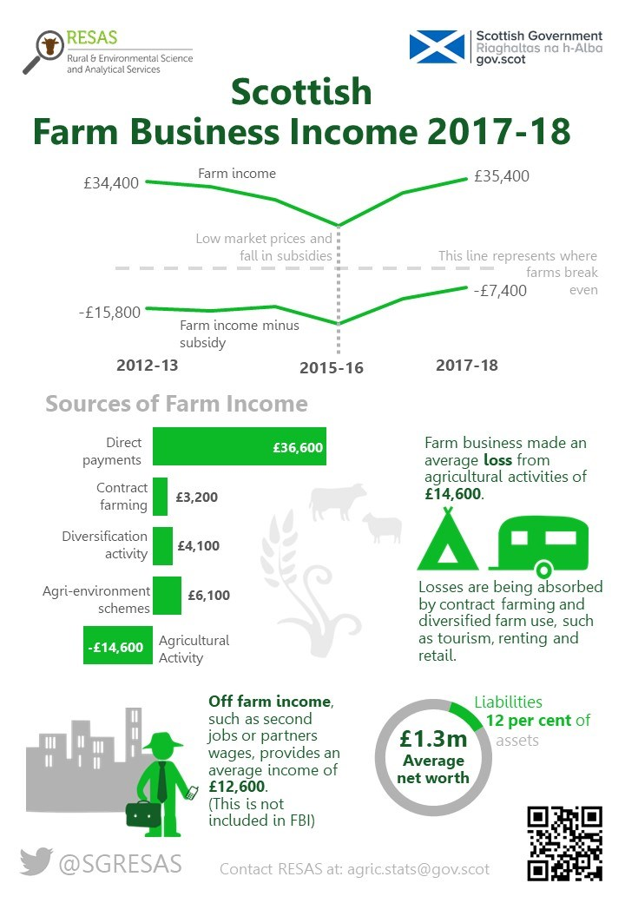
Challenges and Opportunities?
https://www2.gov.scot/Topics/Statistics/Browse/Agriculture-Fisheries/Publications/FBI

Slide 12
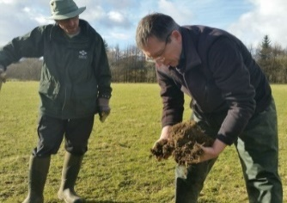
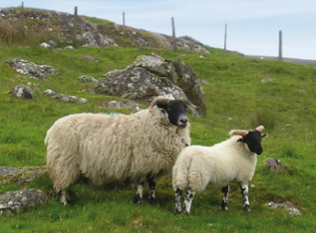
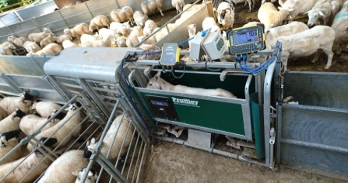
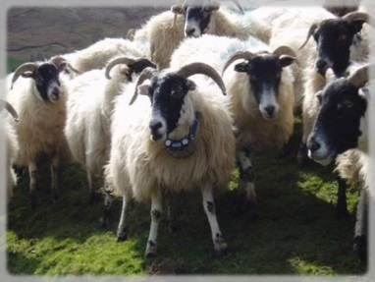
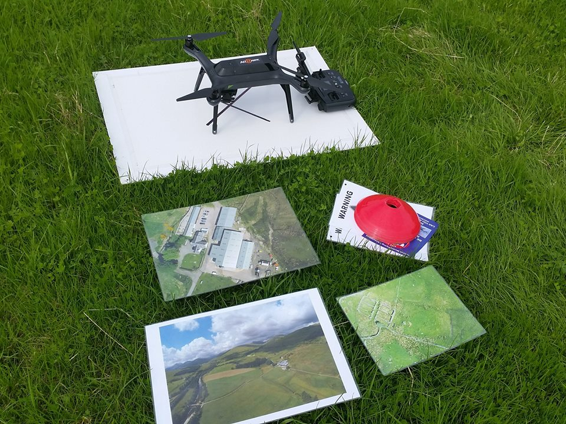
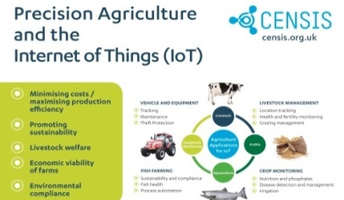
Challenges and Opportunities?
In a time of policy uncertainty
  drop in investment?
  long-term system changes postponed?
Farmers & crofters need to drive changes to improve:
  technical efficiency,
  business viability,
  vibrancy of the sector
Need to support the younger generation
  implement new ideas and take new approaches to farming
Unprecedented period of policy transition
  Need to take stock and create a roadmap for success for Scottish agriculture taking account of its wider rural context

Slide 13
Challenges and Opportunities?
Need to improve cost-effectiveness of production across all sectors
Need to reduce reliance on public subsidy and/or diversify income sources
Brexit will mean increasing uncertainty over agricultural support – at least in short term – but at best amount in the ‘pot’ will remain flat
Government drive to tackle the Climate Emergency and Biodiversity Crisis – farming has a key role to play

Slide 14

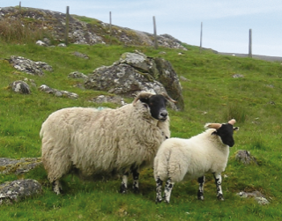


Challenges and Opportunities?
Innovation = Doing Things Differently
Inbye grasslands
Soil pH and nutrients
GHG emissions
Grassland management
Forage & fodder improvements
Sheep Performance
Genetic selections
Blackface and Lleyn
Auchtertyre flock
Restocking
Blackloss
Yellowses/Plochteach
Flock Performance
EID associated kit
TST worming of lambs
Comparison of system trade-offs
Technology
Virtual fencing
Drones for assessments
Hill grazing
Bracken control
Improving hill parks
LoRa network
Tracking livestock
Sensors
Systems approach to
Precision Livestock Farming

Slide 15
Challenges and Opportunities?
Wider Integration & Income Diversification
Tourism business
Peatland Restoration
Environmental management
Woodland creation
Scale of change needed
Innovation = Doing Things Differently
Inbye grasslands
Soil pH and nutrients
GHG emissions
Grassland management
Forage & fodder improvements
Sheep Performance
Genetic selections
Blackface and Lleyn
Auchtertyre flock
Restocking
Blackloss
Yellowses/Plochteach
Flock Performance
EID associated kit
TST worming of lambs
Comparison of system trade-offs
Technology
Virtual fencing
Drones for assessments
Hill grazing
Bracken control
Improving hill parks
LoRa network
Tracking livestock
Sensors
Systems approach to
Precision Livestock Farming

Slide 16

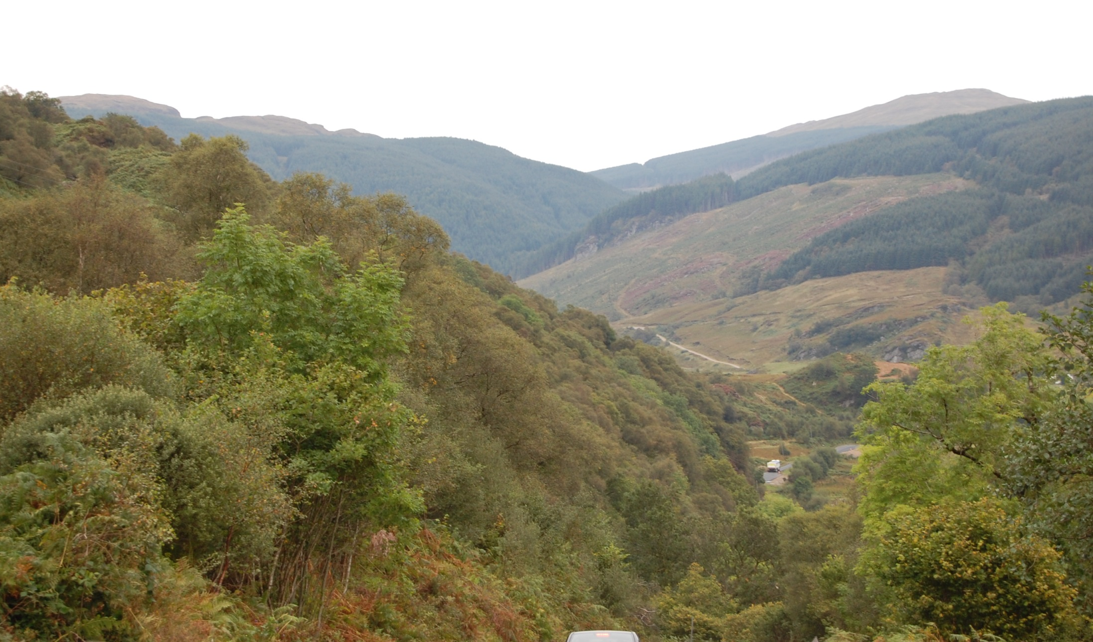
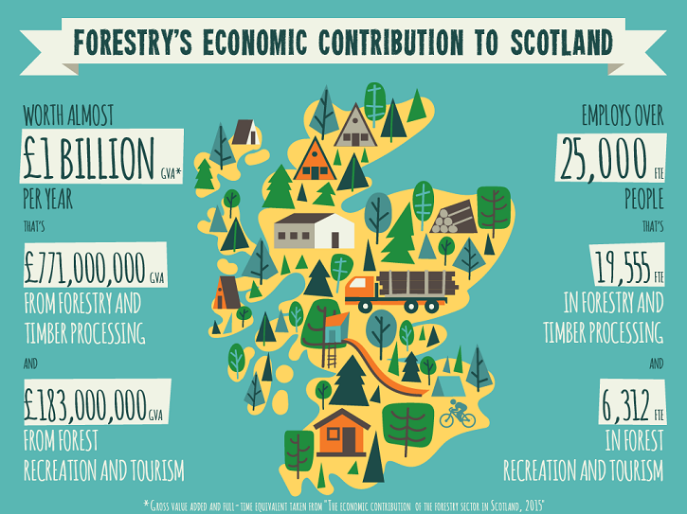
Challenges and Opportunities?
https://www.sruc.ac.uk/downloads/file/3188/section_1_changing_land_management_rsif_2016_pages_8-112

Slide 17

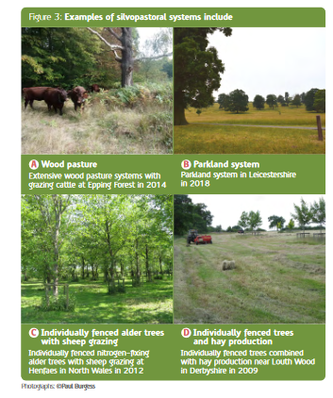
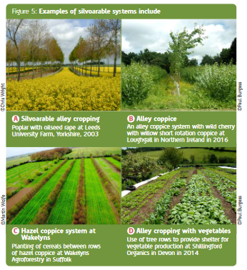
Challenges and Opportunities?
https://www.soilassociation.org/media/19141/the-agroforestry-handbook.pdf

Slide 18
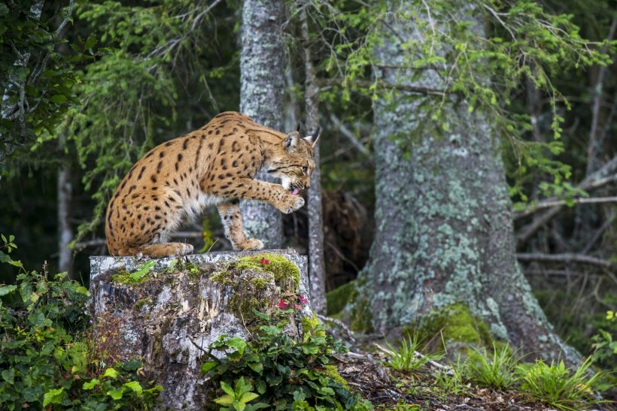
Challenges and Opportunities?

Slide 19
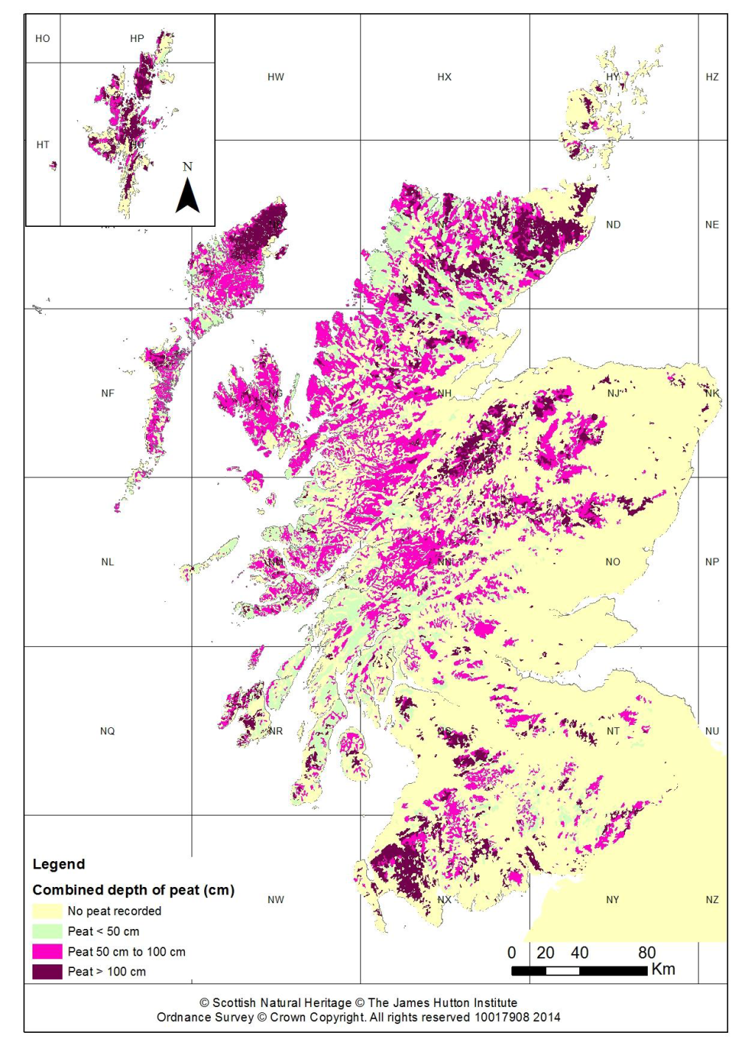
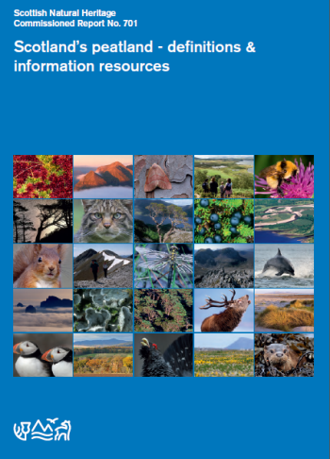
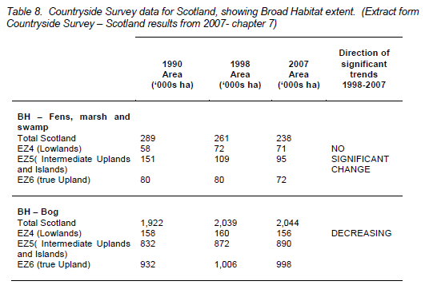
Challenges and Opportunities?
Extent in uplands stable but some decreases in plant species richness and many emitting rather than sequestering carbon

Slide 20

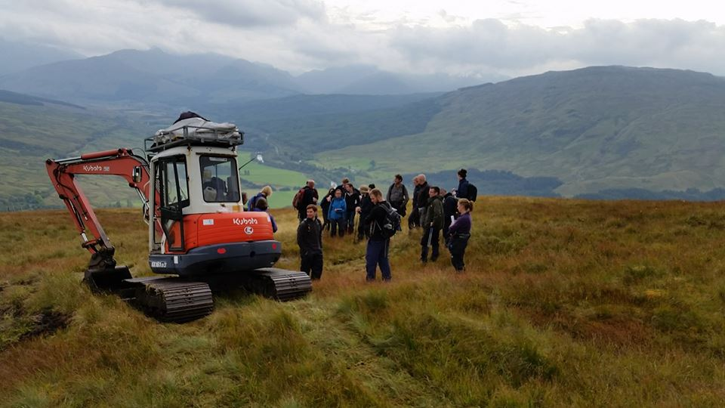
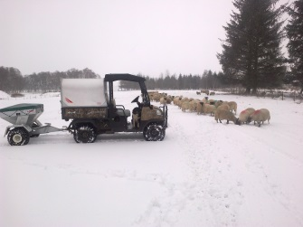
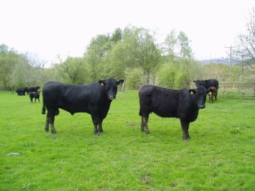
Challenges and Opportunities?

Slide 21




Challenges and Opportunities?
Protecting carbon stocks in soil & vegetation
Reducing flood risk
Increasing woodland cover
Supporting rural communities
Maintaining local employment opportunities
Maintaining safe access routes for hill walkers
Supporting wider Scottish economy
Maintaining the land for future generations
Maintaining good quality food production
Maintaining habitats and wildlife species
Preventing and controlling wildfires
Improving water quality
Maintaining landscapes for tourism
Maintaining cultural heritage
Approach
Ecosystem

Slide 22
Challenges and Opportunities?
Greater integration with other land uses has to be way forward to increase income, spread risk and increase resilience
Each land-holding has to investigate what options are most appropriate – both individually and in combination with others – for their own situation

Slide 23


Land Use Conference 2018:
Event Rationale:
https://sefari.scot/blog/2018/11/27/how-might-our-farmers-adapt-to-a-public-money-for-public-goods-regime
Twenty Presentations:
https://www.sruc.ac.uk/info/120470/land_use_conference
Overview of the event:
https://www.sruc.ac.uk/news/article/2285/dynamic_backdrop_for_land_use_event
Twenty-Seven Short Interviews:
https://youtu.be/76VBqIT64J4?list=PLUlAOo37Qn6LuzlzMuVWZ8Q76PXyprPCr

Slide 24
SRUC receives research funding from the Rural & Environment Science & Analytical Services Division of the Scottish Government through their 2011-2016 and 2016-2021 Strategic Research Programmes
Additional funders of research from 2016 onwards include:
The European Commission’s H2020 Research & Innovation Programme
Defra under the ERA-NET SusAn (Sustainable Animal Production) Programme
Global Food Security’s ‘Resilience of the UK Food System Programme’, with support from BBSRC, ESRC, NERC and Scottish Government.

Slide 25










Innovation = Doing Things Differently
Engineering
& Technology
Knowledge
Transfer
Systems
& ecology
Biological
Sciences

